Slide 1
Travelling

Slide 2
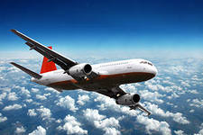
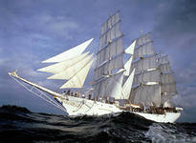
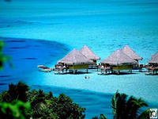
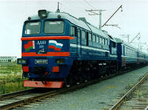
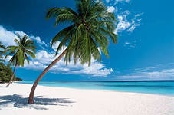
We shall speak about…
travelling.

Slide 3
Read the words one by one.
travelling
tourism
on foot
by car
by plane
by ship
a ticket
expensive
wonderful
comfortable
to discover
путешествие
туризм
пешком
на машине
на самолете
на корабле
билет
дорогой
удивительный
удобный
узнавать

Slide 4
Make up the word combinations.
a wonderful travelling
to travel ticket
an expensive car
to discover on foot
a map new places
a comfortable of Asia

Slide 5
Fill in the words from the table.
People buy … before travelling.
People would visit a lot of … .
Travelling by car ….
Travelling by plane is the most .. .
People prefer … in summer.
Tourism teaches people about art and..

Slide 6
Fill in the words from the table.
People buy before travelling.
People would visit a lot of .
Travelling by car is .
Travelling by plane is the most .
People prefer in summer.
Tourism teaches people about art and
tickets
places
comfortable
expensive
to travel
culture

Slide 7
Read the proverbs.
Every country has its customs.
East or West home is best.
There is no place like home.

Slide 8
Make up the sentences.
East or West has like home.
Every country has home is best.
There is no place its customs.

Slide 9
Make up the sentences.
East or West has like home.
Every country has home is best.
There is no place its customs.

