Slide 1
The mass media

Slide 2
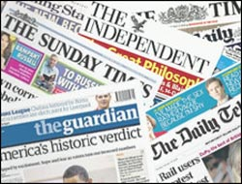
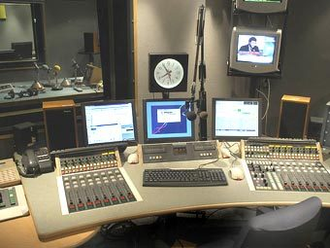
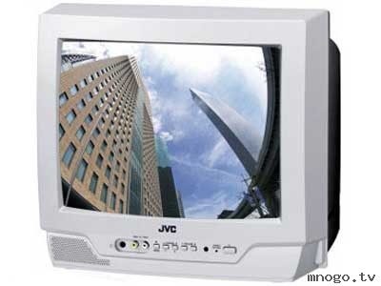
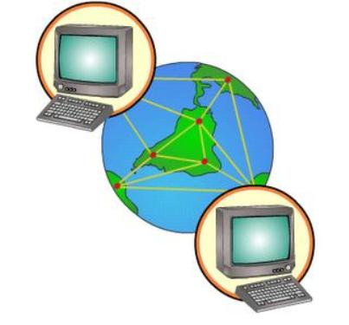
Newspapers
Radio
The Media
Television
The internet

Slide 3
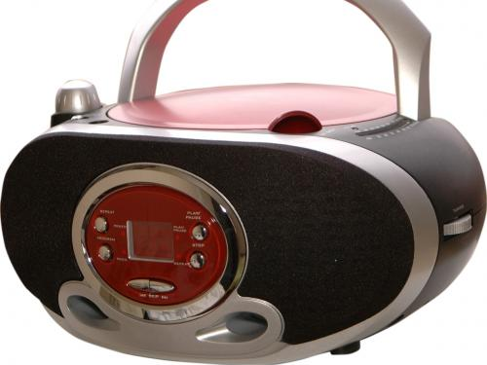
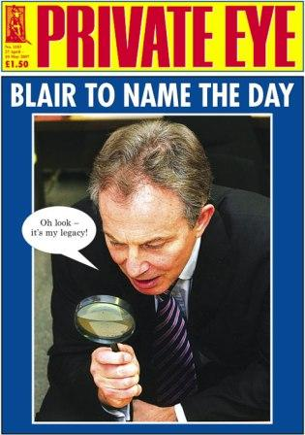
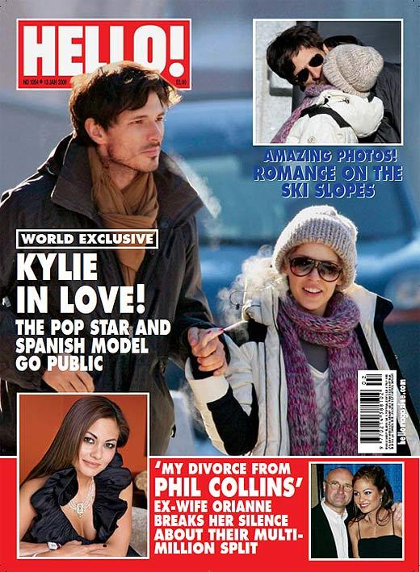
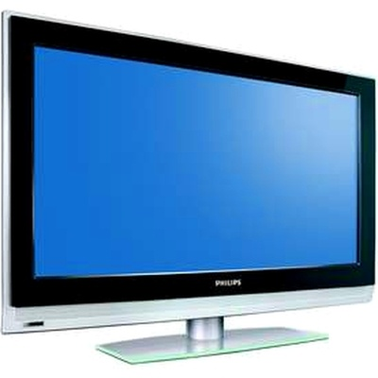
educate
inform
The role of the Media in our life
entertain

Slide 4
How do people use the media?
?

Slide 5
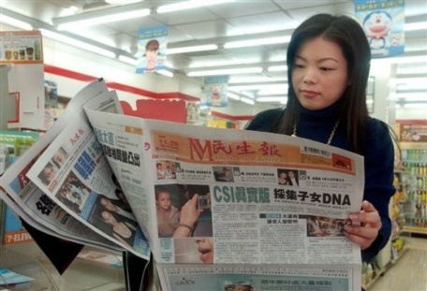
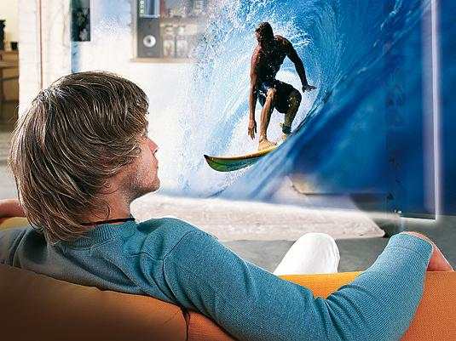
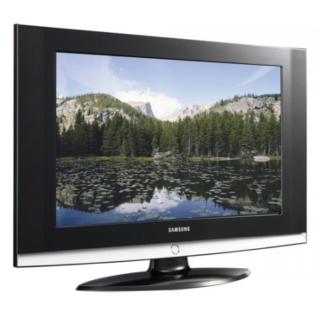
The media help people
To receive information – получать информацию
To relax- отдыхать
To entertain -развлекать
To travel around the world without wasting money- путешествовать по миру без затрат

Slide 6
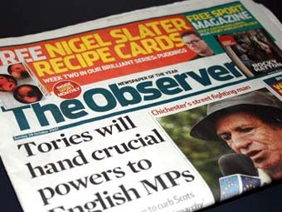
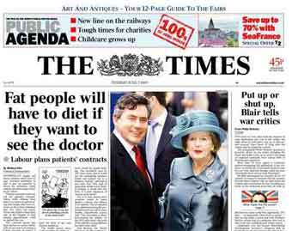
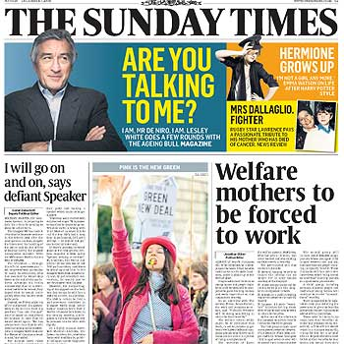
What is a Newspaper ?
printed -напечатанный
It is a paper printed and sold daily or weekly with news , advertisements , articles about political, crime, business , art, entertainment , sport events.
Sold - продаваемый
news - новости
Article-статья
Advertisement - реклама
Crime -преступление
Entertainment -развлечение

Slide 7
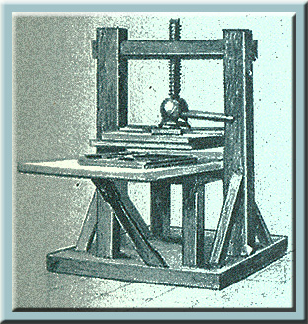
Newspapers in Britain
Printing press was invented in the15th century in Germany
!
The first newspaper in Britain appeared in 1513.

Slide 8
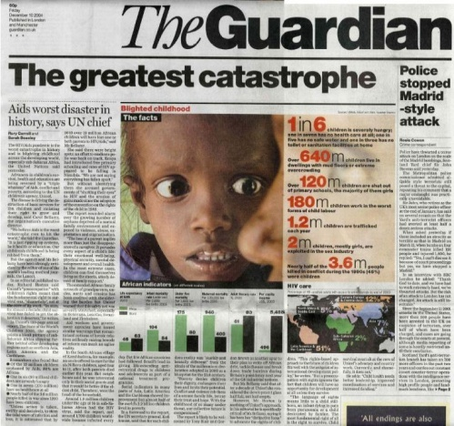
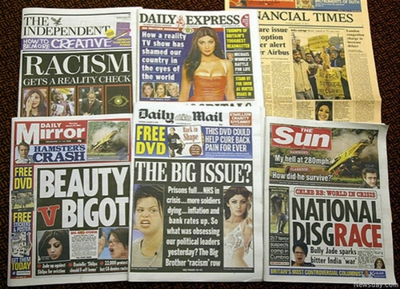
More credible
Contain political, industrial, financial and cultural news
Quality papers
There are two kinds of newspapers in Britain
Tabloids
Less credible
Sensationalism

Slide 9
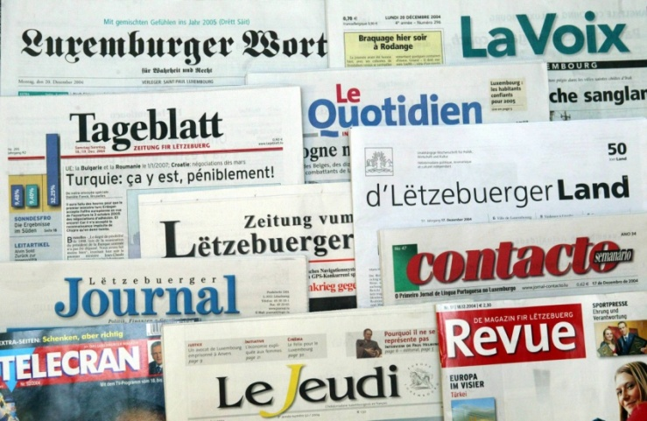
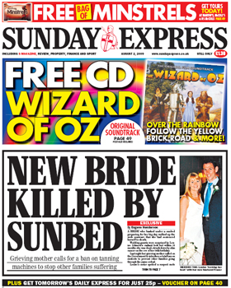
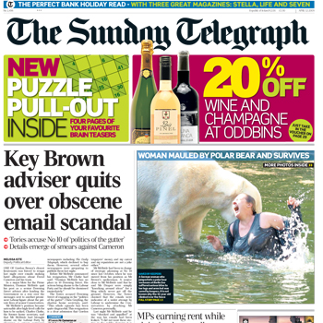
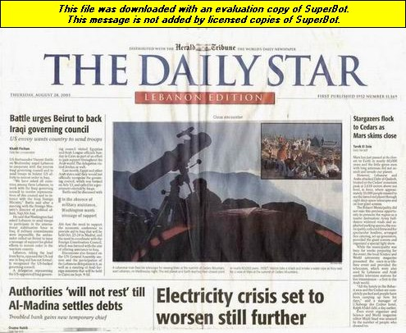
Newspapers are divided
Daily
Sunday
Published on every day of the week except Sunday
They are larger then daily ones

Slide 10
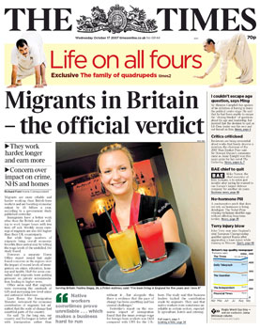
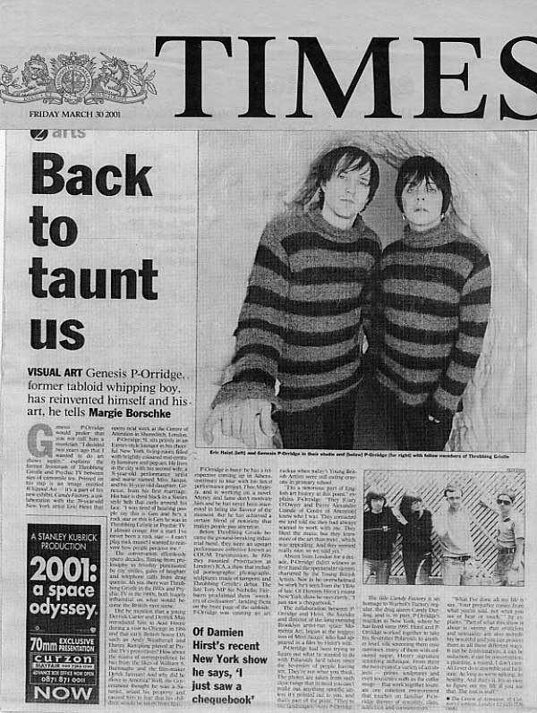
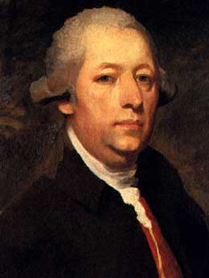
Newspapers in Britain
The longest running British newspaper is The Times began in 1785.
John Walter was a founder of The Times newspaper, London.

Slide 11
Do you like to read newspapers?
What newspapers for children do you know?
What is your favourite newspaper?
How often are you delivered it?
What articles do you like to read?
The Newspaper is the only national newspaper for 8 to 14 year old children designed for the classroom. It is produced by a small team of teachers and journalists.
It was first published in April 2000 and has been delivered to schools every half term since.
Newspapers for children

Slide 12
Check yourself

Slide 13
What is a radio?
The process of sending and receiving messages through the air , broadcasting programmes for people to listen to
People can
get news- узнать новости
take part in talk shows- принимать участие в ток-шоу
listen to music-послушать музыку

Slide 14
Find the correct translation
1.Listen to the radio
a.Включить радио
2.Turn the radio on
b.Слушать радио
c.Слушать новости по радио
3.Miss a radio programme
4.Get news over the radio
d.Пропустить радиопередачу

Slide 15
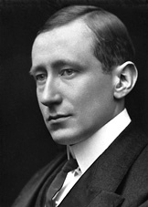
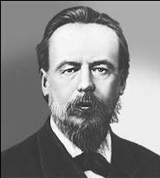
Who invented
a radio ?
Guglielmo Marconi was an electrical engineer and Nobel laureate known for the development of a practical wireless telegraphy system.
In 1896, he was awarded a patent for radio with British Patent .
On May 7, 1895 the Russian physicist Alexander Popov performed a public demonstration of transmission and reception of radio waves used for communication .This day has since been celebrated in Russia as “Radio Day”
Nikola Tesla developed means to reliably produce radio frequencies, publicly demonstrated the principles of radio, and transmitted long distant signals.

Slide 16
A Radio in the UK
BBC radio
A service of the British Broadcasting Corporation which has operated in the United Kingdom
BBC operates more than 40 stations that comprise 50% of all radio listening in the UK
The BBC radio services began in 1922.
Commercial Radio:
Started in 1970s, now includes over 300 private stations.

Slide 17
BBC studio
What does a radio studio look like?
How do announcers work ?
Have you ever seen the BBC studio?

Slide 18
Uncountable
nouns
Check yourself!
Newspaper – newspapers
Work – a lot of work
Snow- much snow
Food- much food
Cinema- cinemas
Money- a lot of money
Juice- much juice
Make the plural nouns
Newspaper –
Work –
Show-
Food-
Cinema-
Money-
Juice-
countable
We can count
We can not count
Computer –computers
Newspaper- newspapers
Message – messages
Book- books
Water
Snow
News
Weather
Food
TV
air
a/an
a/an
some/any
a lot of / little

Slide 19
Check yourself

Slide 20
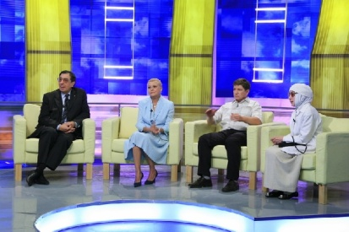
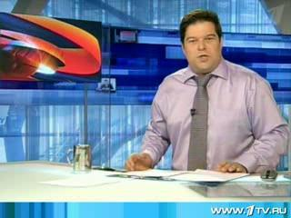
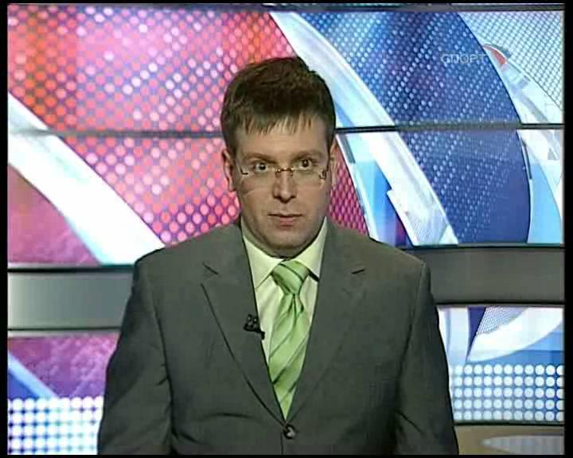
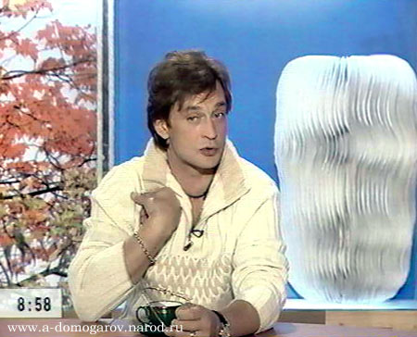
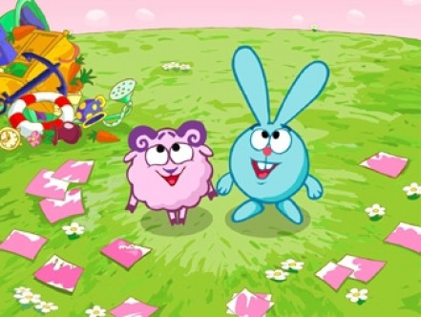
Broadcasting(вещатель-ные)programmes (the news, plays,advertisements, shows) for people to watch on their television sets
What is TV ?

Slide 21
An advertisment
a commercial interruption, where a a thing, a product or a service are advertised . It helps people to choose best things.
Реклама

Slide 22
A documentary
A programm which gives facts and information about a particular subject
Документальный фильм

Slide 23
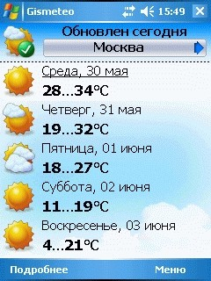
A Weather forecast
A programm ,where the announcer says what the weather will be like the next day.
Прогноз Погоды

Slide 24
Talk show
It is a discussion, where different problems are discussed by participants . They express their opinions, ask and answer questions.
Ток -шоу

Slide 25
Match the words with the definitions
a. a commercial interruption, where a thing, a product or a service are advertised . it helps people to choose best things.
1.A documentary
b.produced by recording images from the world with cameras, or by creating images using animation techniques or visual effects.
2.A quiz show
c. A programm which gives facts and information about a particular subject
3.An advert
e. A programmer ,where sport events are told
4.A cinema
5.Sport news
d.People take part in a competition there . They are asked questions , they can win or lose the game. If they are in luck , they get a prize.

Slide 26
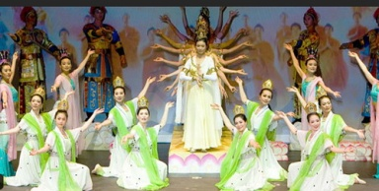
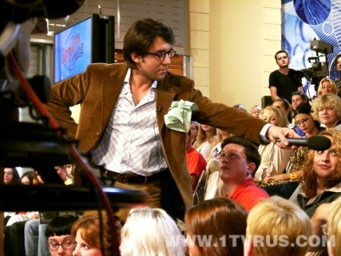
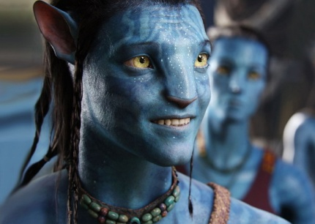
Match the definitions with the pictures
aThere are a lot of music In this kind of programmers, we can watch singers and listen to songs
1.
2.
b.A film with a lot of series , which is shown during a long time
c. A discussion, where different problems are discussed by participants . They express their opinions, ask and answer questions.
3.
d.A film with a lot of sepias , which is shown during a long time
5.
4.
e.produced by recording images from the world with cameras, or by creating images using animation techniques or visual effects.

Slide 27
Check yourself!
2.
a.There are a lot of music In this kind of programmers, we can watch singers and listen to songs
b.A film with a lot of series , which is shown during a long time
1.
3.
c. A discussion, where different problems are discussed by participants . They express their opinions, ask and answer questions.
5.
d.A programmer ,where the announcer says what the weather will be like the next day.
4.
e.produced by recording images from the world with cameras, or by creating images using animation techniques or visual effects.

Slide 28
What is it?
A cinema
A soap opera
A music programm

Slide 29
What is it?
advert
A music programme
A talk show

Slide 30
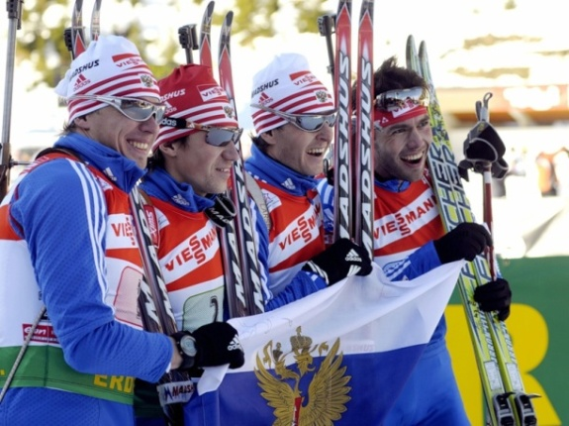
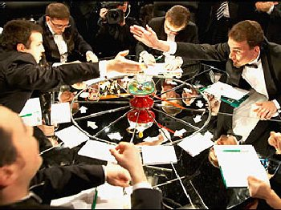
What is it?
Sport news
A quiz show
News

Slide 31
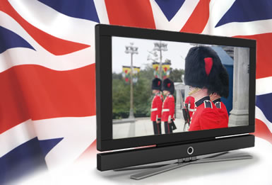
The British Television
There are 940 television broadcasts stations; 400 different TV channels in The UK.
Major British TV Channel is BBC.
BBC operates 14 different television channels

Slide 32
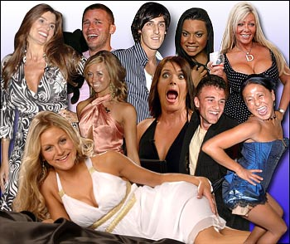
Reality TV in Britain
Programmes which ordinary people into the public eye are enjoying a wave of popularity
Popular reality TV shows in the UK
X Factor
Strictly Come Dancing
Big Brother

Slide 33
Check yourself

Slide 34
It was invented in the USA in 1965
A worldwide system of interconnected networks and computers.

Slide 35
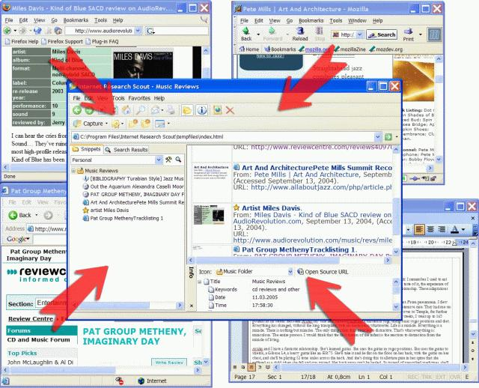
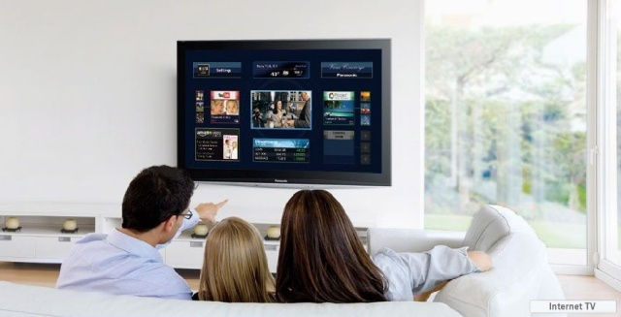
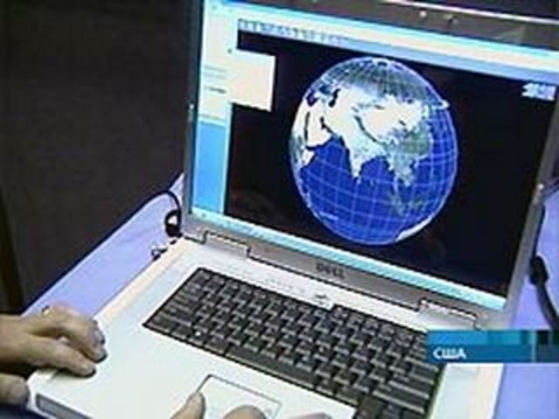
Research ,getting necessary information
Online shopping
Talking to friends
What can you do
in internet?
Download music
Downloading/
listening to music
Watching Videos

Slide 36
Disadvantages
Advantages
Disadvantages:
It promotes violence and bad behaviour within society,
It stops children from going out, as they wish to stay home and use the internet to talk to friends , to play games
Allows easy and quick access to information
People can purchase products, talk to people and much more online
Downloading music- quick and easy

Slide 37
Check yourself

Slide 38
Progress test

Slide 39
You are wrong!
Try again!
Correctly answer

Slide 40
!
Excellent!
!
You are right!

Slide 41
You are right! Go on!
!

Slide 42
Think …

Slide 43
You are wrong!

Slide 44
You are right!
!

Slide 45
You are wrong!

Slide 46
You are right!
!

Slide 47
You are wrong!

Slide 48
You are wrong!

